Slide 1
TO DO LIST WEB APPLICATION
BY: EBONICA SALETH
E-MAIL ID: ebonicasalethvincent@gmail.com

Slide 2
INTRODUCTION
In today's fast-paced world, staying organized and managing tasks efficiently is a constant challenge. The To-Do List web application is your digital companion, designed to simplify your life and help you achieve your goals. Whether it's juggling work responsibilities, personal errands, or long-term aspirations, this application offers a versatile solution to keep you on the path to success.
FEATURES :
My To-Do List web application provides you with an elegant and intuitive user interface. You'll find a dose of motivation through inspirational quotes, keeping you focused and determined.
Easily add and delete tasks, making task management a breeze. With accessibility from any device with an internet connection, you can ensure your to-do list is always at your fingertips.

Slide 3
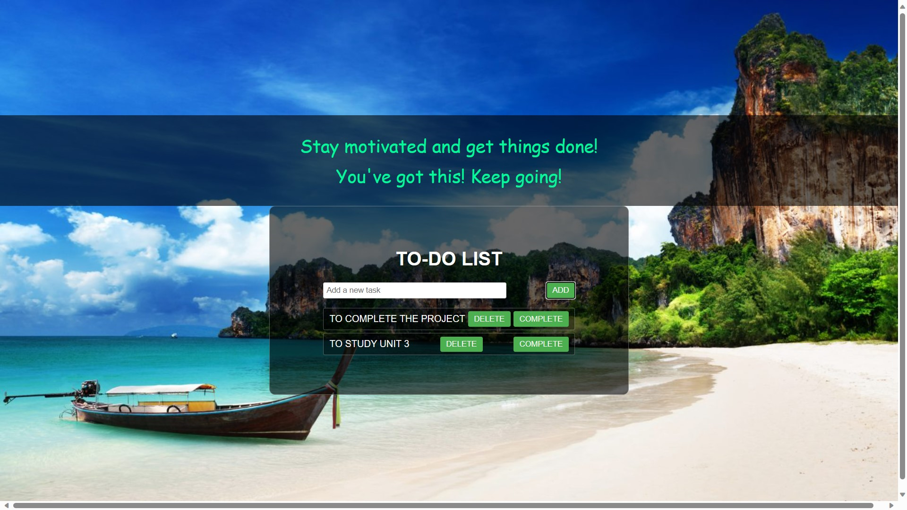
WORKING
How To-Do List Web App Works

Slide 4
WORKING
Creating a Task:
Enter your task in the input field.
Click the "ADD" button to add the task to the list.
Managing Tasks:
Check off completed tasks.
Easily add and remove tasks as needed.

Slide 5

PRACTICAL USES OF TO-DO-LIST WEB APPLICATION
Personal Organization
Keep track of daily tasks.
Set reminders for important events.
Work Efficiency
Manage projects and deadlines.
Collaborate with colleagues by sharing lists.
Goal Setting
Plan long-term goals and monitor progress.
Stay motivated with daily quotes.

Slide 6
ADVANTAGES
Productivity Boost
Efficiently manage tasks.
Reduce procrastination.
Motivation
Stay motivated with inspiring quotes.
Achieve more with a positive mindset.
Accessibility
Access your to-do list from anywhere with an internet connection.
Cross-device synchronization.

Slide 7
DISADVANTAGES
Digital Overload
Overreliance on digital tools.
May lead to screen time concerns.
Learning Curve
Some users may find it challenging to adapt.
Initial setup and learning required.

Slide 8
FUTURE SCOPE
Integration with Smart Assistants
Compatibility with voice assistants for hands-free task management.
AI-Powered Recommendations
Predictive task suggestions based on user habits and goals.
Enhanced Collaboration
Real-time collaboration and chat features for group tasks.

Slide 9
CONCLUSION
Recap of key points:
To-Do List Web App helps users stay organized and motivated.
It has various practical uses and advantages.
Consider potential disadvantages and future advancements.

Slide 10
THANK YOU

